Slide 1
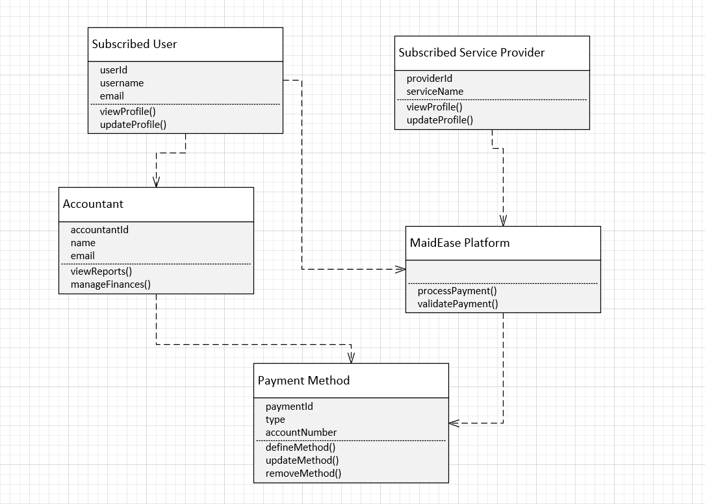
04.01 Define Payment Method Class Diagram

Slide 2
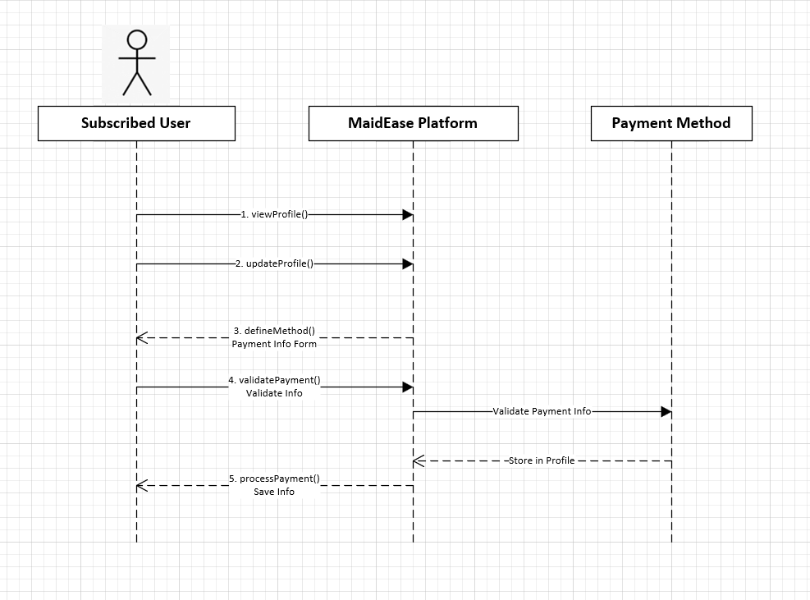
04.01 Define Payment Method Sequence Diagram

